Slide 1
Advanced Models I -Introduction to Neural Networks
Aug. 6th, 2024

Slide 2
Contents
Part 1: Linear Models
Part 2: Neural Networks
Introduction to linear regression
Prediction and estimation
Regression analysis
Logistic regression
Introduction to neural networks
Neural networks, today and in the past
Biological and artificial neural networks
How networks are trained
Let’s build our own networks!
Convolutional neural networks for visual recognition
Linear regression
Multilayer neural networks
Logistic regression
Single-layer neural networks
Convolutional neural networks

Slide 3

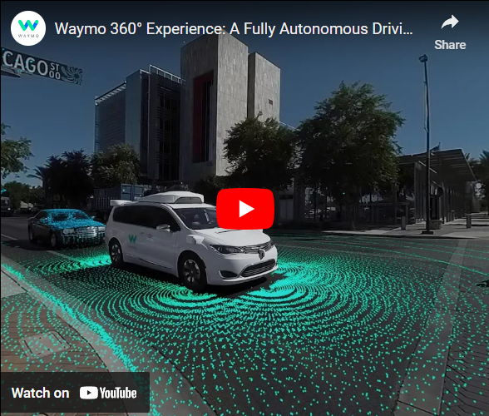
Artificial Neural Networks Today
AI Driving Cars
Self-driving vehicles are often powered by neural networks
Used to recognize objects on the road and to make decisions
https://medium.com/@andrewng/self-driving-cars-are-here-aea1752b1ad0
Link to video: https://www.youtube.com/watch?v=B8R148hFxPw

Slide 4
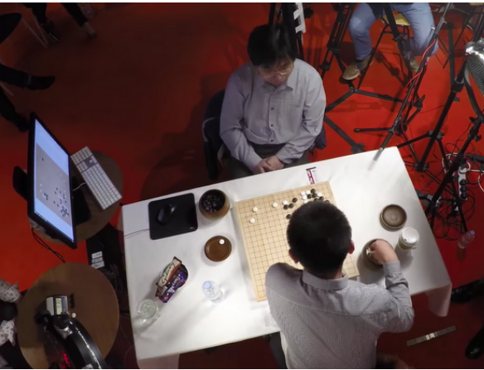
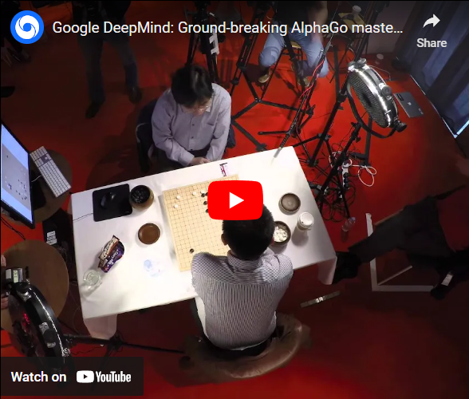
Artificial Neural Networks Today
AI Playing Go
Over a googol times as many board states as chess
Intuitive play
DeepMind defeated first ranked player Ke Jie in May 2017
https://blog.google/technology/ai/alphago-machine-learning-game-go/
Link to video: https://www.youtube.com/watch?v=SUbqykXVx0A

Slide 5
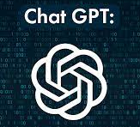

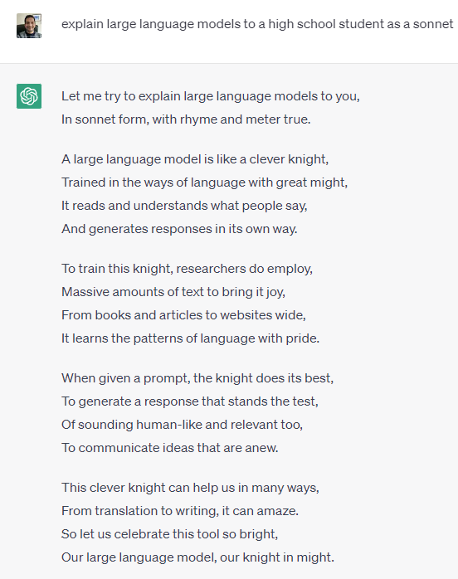
Artificial Neural Networks Today

Slide 6
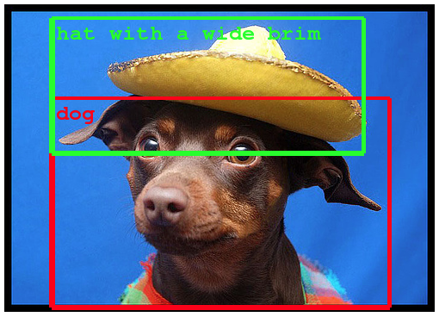
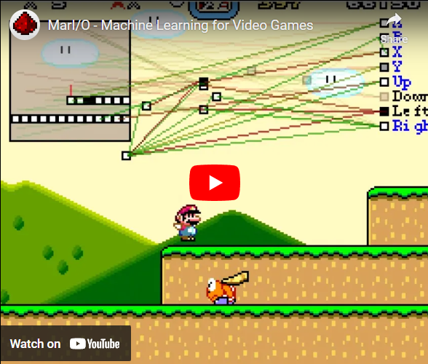
Artificial Neural Networks Today
Object Recognition
Learn to recognize objects in complicated images, videos, or even video games
https://ai.googleblog.com/2014/09/building-deeper-understanding-of-images.html
Link to video: https://www.youtube.com/watch?v=qv6UVOQ0F44

Slide 7
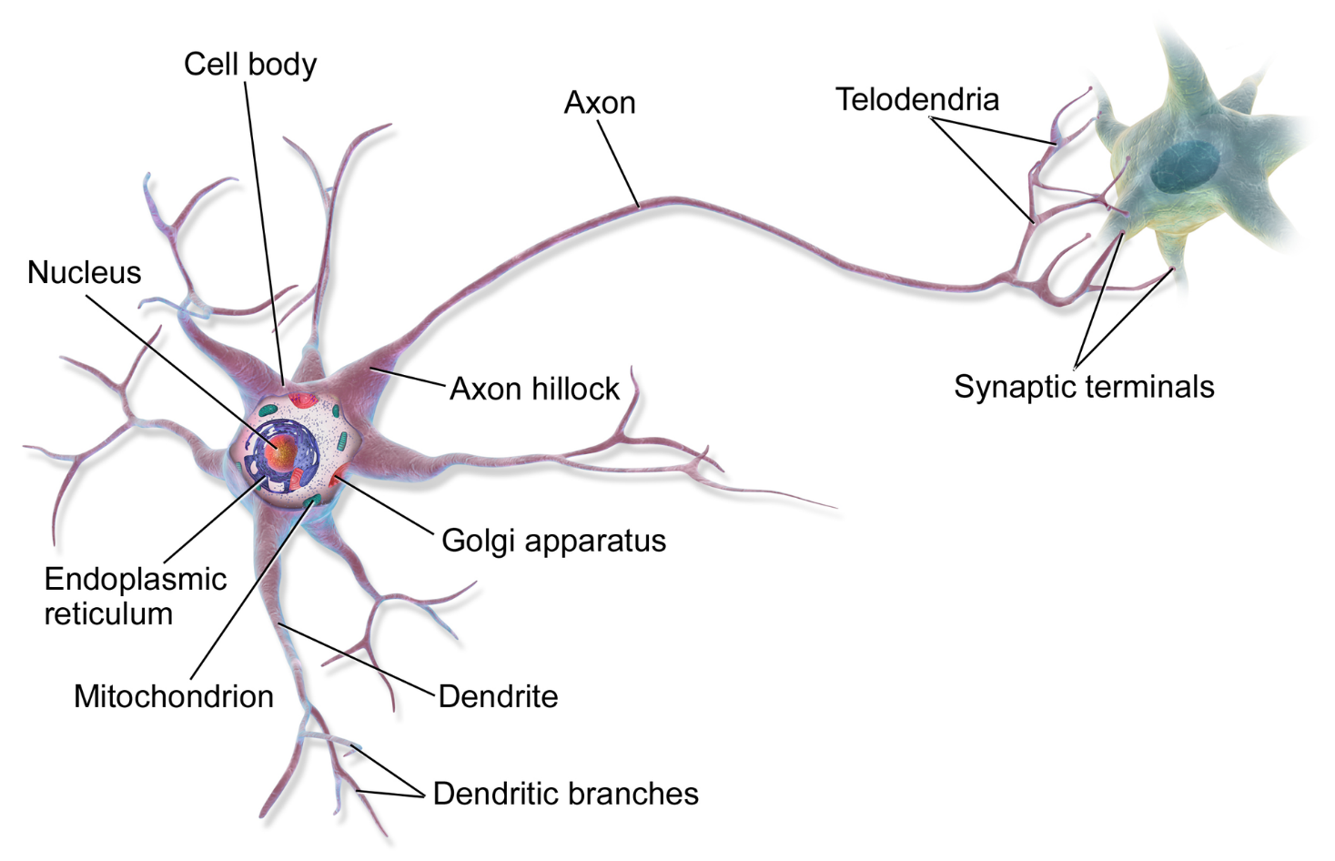
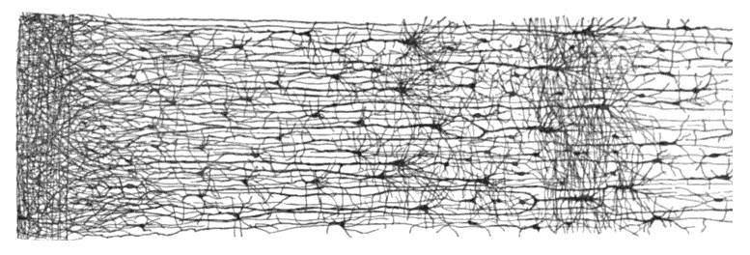
Biological Neurons and Biological Neural Network (BNN)
Receive input information with dendrites
Process information in the cell body
Send output information with the axon (or do nothing)
BNN: layer structure
By BruceBlaus - Own work, CC BY 3.0,
https://commons.wikimedia.org/w/index.php?curid=28761830
By Santiago Ramon y Cajal, showing the dendrites and axons of neurons in human infant cerebral cortex, Cerebral cortex - Wikipedia

Slide 8



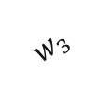

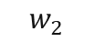
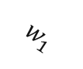


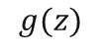


Inspiration from Neuroscience: Artificial Neurons and Artificial Neural Network (ANN)
Basic idea:
Individual artificial neurons carry out simple calculations.
A large network of artificial neurons perform complex calculations.
$$x_{1}$$
$$b$$
?
$$w_{1}$$
$$x_{2}$$
$$w_{2}$$
$$z$$
$$g(z)$$
$$Y$$
$$w_{3}$$
$$x_{3}$$
Neuron
Output
Neurons (hidden layers)
Input
Input layer
Output layer

Slide 9



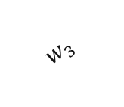
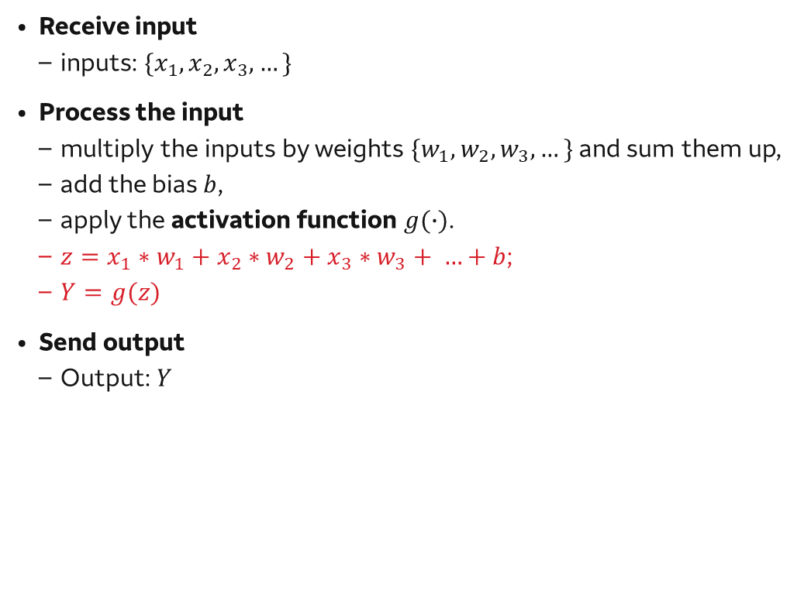


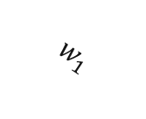



Artificial Neurons
$$b$$
Receive input
inputs: $\{x_{1},x_{2}, x_{3},…\}$
Process the input
multiply the inputs by weights ${\{w}_{1},w_{2}, w_{3}, …\}$ and sum them up,
add the bias $b$,
apply the activation function $g(∙)$.
$z=x_{1}∗w_{1}+x_{2}∗w_{2}+x_{3}∗w_{3}+ …+b$;
$Y=g(z)$
Send output
Output: $Y$
$$x_{1}$$
$$w_{1}$$
$$x_{2}$$
$$w_{2}$$
$$z$$
$$g(z)$$
$$Y$$
$$w_{3}$$
$$x_{3}$$
Neuron
Output
Input

Slide 10
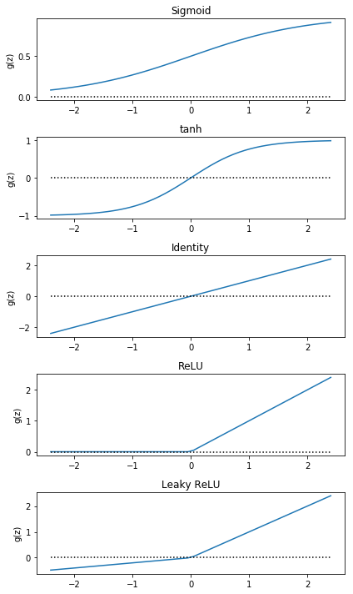
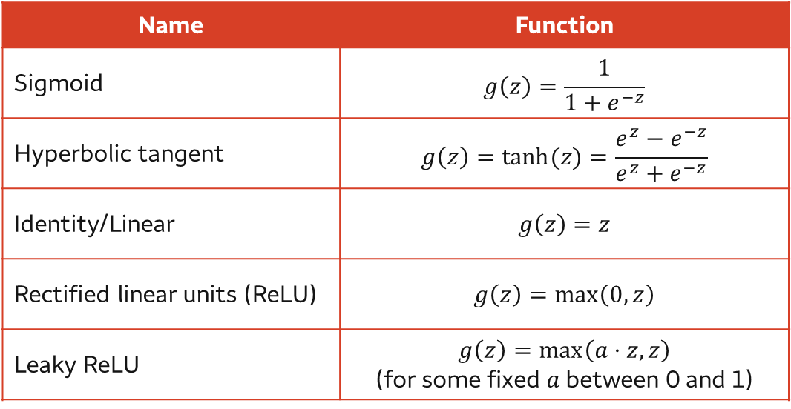

Artificial Neurons Activation Functions
Question: What do these activation functions have in common?
In the early days, a step function was used as the activation function.
Heaviside step function: $g\left(z\right)=\left\{\begin{aligned}0, z<0 \\ &1, z≥0\end{aligned}\right.$
Interpretation: the neuron being “on” or “off”.
Modern neural networks use a variety of activation functions
Name | Function
Sigmoid | $$g\left(z\right)=\frac{1}{1+e^{−z}}$$
Hyperbolic tangent | $$g\left(z\right)=\tanh{(z)}=\frac{e^{z}−e^{−z}}{e^{z}+e^{−z}}$$
Identity/Linear | $$g\left(z\right)=z$$
Rectified linear units (ReLU) | $$g\left(z\right)=\max\left(0,z\right)$$
Leaky ReLU | $$g\left(z\right)=\max\left(a⋅z, z\right)$$ (for some fixed $a$ between 0 and 1)

Slide 11



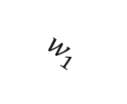


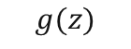


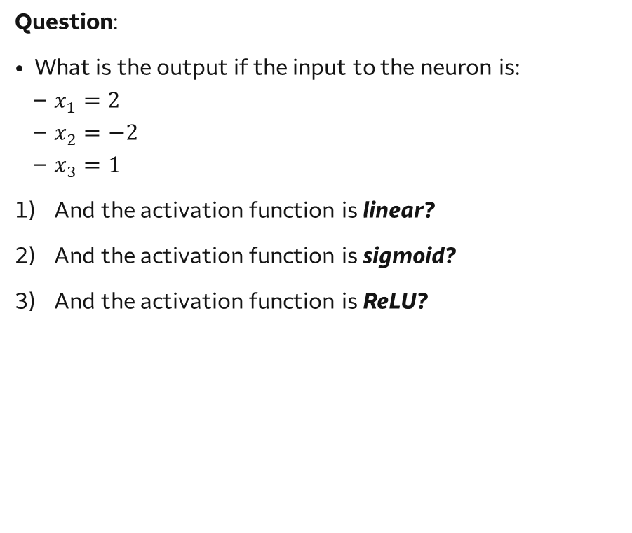


Practice
Let’s look at a concrete example of the calculations carried out by artificial neurons.
Suppose we have a neuron with:
$w_{1}=2$
$w_{2}=0$
$w_{3}=−1$
$b=2$
Question:
What is the output if the input to the neuron is:
$x_{1}=2$
$x_{2}=−2$
$x_{3}=1$
And the activation function is linear?
And the activation function is sigmoid?
And the activation function is ReLU?
$$x_{1}$$
$$b$$
$$w_{1}$$
$$x_{2}$$
$$w_{2}$$
$$z$$
$$g(z)$$
$$Y$$
$$w_{3}$$
$$x_{3}$$
Neuron
Output
Input
Notes:
This is meant to be a quick, but concrete example of the types of calculations artificial neurons carry out.

Slide 12
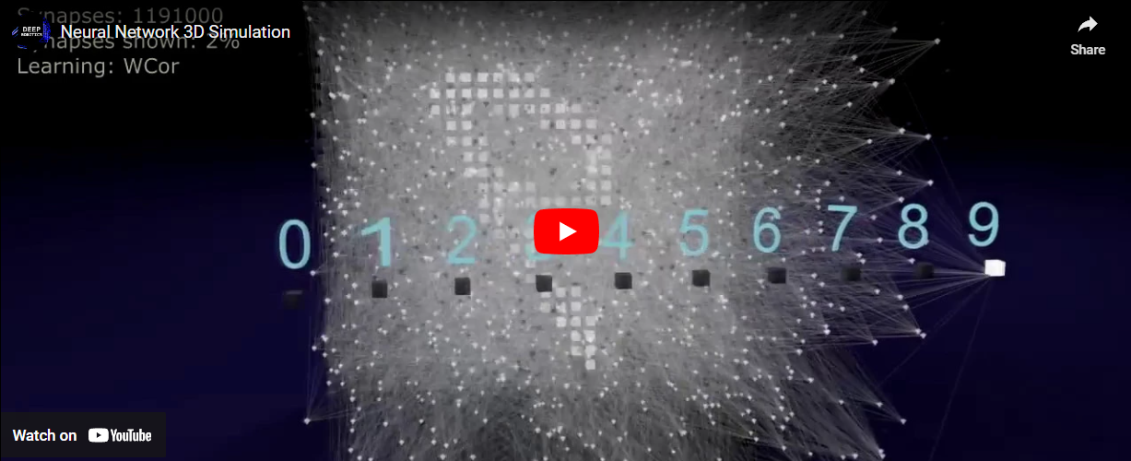
Neural Network 3D Simulation
Link to video: https://www.youtube.com/watch?v=3JQ3hYko51Y

Slide 13







Perceptron Networks with a Single Layer of Neurons
It is one of the simplest ANN architectures.
It is composed of a single layer of neurons with Heaviside step function as the activation function.
Every neuron is connected to every input -> fully connected layer/ dense layer.
Single-layer perceptrons can solve linearly separable problems.
It cannot solve exclusive OR (XOR) classification problem.
$$x_{1}$$
$$z_{1}$$
$$Y_{1}$$
$$x_{2}$$
$$z_{2}$$
$$Y_{2}$$
$$x_{3}$$
Input
Neurons
Output
Notes:
Spend a little time here, working through how information moves through the network.
Note: It is fun to say “Universal Approximation Theorem” in an artificially deep voice, before extracting the important idea.

Slide 14
Multilayer Perceptrons (MLP)
Limitations can be eliminated by stacking multiple perceptrons!
First layer: input layer (no calculation)
Mid layers: hidden layer (run calculation)
Last layer: output layer (run calculation)
Input layer
Output layer
Output
Hidden layer
Notes:
Spend a little time here, working through how information moves through the network.
Note: It is fun to say “Universal Approximation Theorem” in an artificially deep voice, before extracting the important idea.

Slide 15
Deep Neural Networks (DNN)
It’s an ANN with a deep stack of hidden layers (10~100+).
Flexible choice of activation functions.
A large enough DNN with non-linear activations can theoretically approximate any continuous function.
Input layer
Hidden layers
Output layer
Output

Slide 16
Activation Functions Revisited Hidden Layer VS Output Layer
Hidden layers:
Do not directly produce output/ make predictions.
All hidden layers use the same activation function.
Prefer differentiable nonlinear activation functions:
sigmoid, hyperbolic tangent, ReLU.
Output layer:
Directly generate output/ make predictions.
Choose activation functions to match the result/ response variable format.
Example:
Input layer
Hidden layers
Output layer
Output
Problem | Response Variable | Activation Function | What It Does
Binary classification | Binary | Sigmoid | Forces the output be either 0 or 1
Linear regression | Continuous | Linear or identity | Doesn’t restrict the output, by leaving it “as-is”

Slide 17
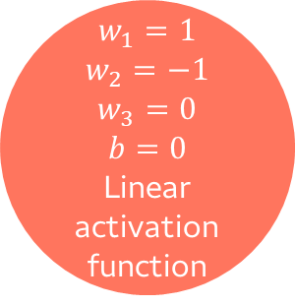

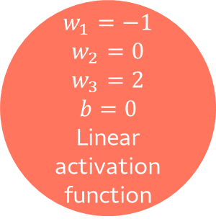





Practice
Question: What is the output of the network if the input is…?
$x_{1}=2$
$x_{2}=−2$
$x_{3}=1$
$$w_{1}=1$$
$$w_{2}=−1$$
$$w_{3}=0$$
$$b=0$$
Linear activation function
$$x_{1}$$
$$w_{1}=−1$$
$$w_{2}=1$$
$$b=1$$
Sigmoid activation function
$$x_{2}$$
$$Y$$
$$w_{1}=−1$$
$$w_{2}=0$$
$$w_{3}=2$$
$$b=0$$
Linear activation function
$$x_{3}$$
Output
Input layer
Hidden layer
Output layer
Notes:
DON’T ACTUALLY WORK THROUGH THIS EXAMPLE. Briefly discuss what you would do. The goal is to give a sense of how simple calculations can build in complexity when there are many units.

Slide 18
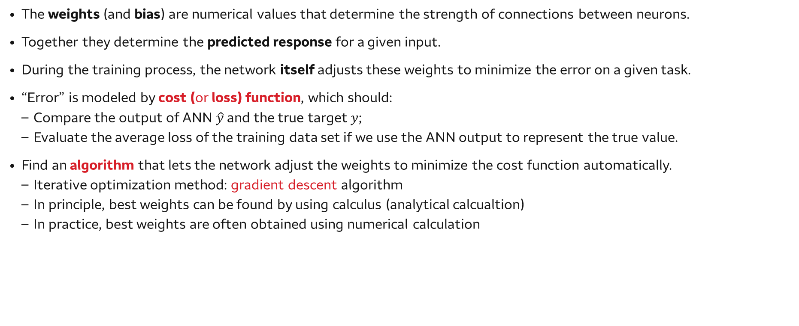
How to Train Neural Networks
The weights (and bias) are numerical values that determine the strength of connections between neurons.
Together they determine the predicted response for a given input.
During the training process, the network itself adjusts these weights to minimize the error on a given task.
“Error” is modeled by cost (or loss) function, which should:
Compare the output of ANN $\hat{y}$ and the true target $y$;
Evaluate the average loss of the training data set if we use the ANN output to represent the true value.
Find an algorithm that lets the network adjust the weights to minimize the cost function automatically.
Iterative optimization method: gradient descent algorithm
In principle, best weights can be found by using calculus (analytical calcualtion)
In practice, best weights are often obtained using numerical calculation

Slide 19
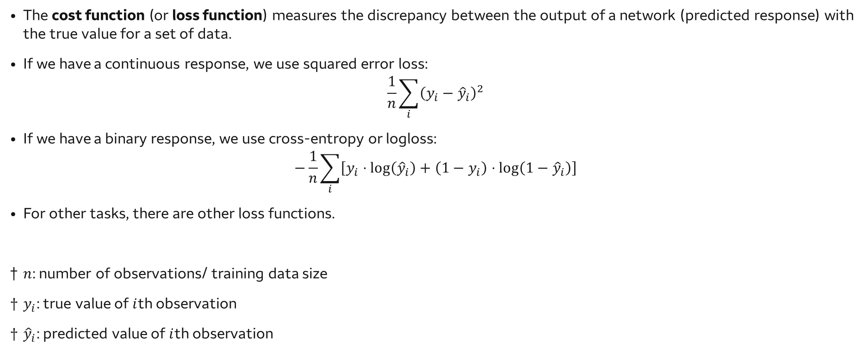
How to Train Neural Networks Cost Functions
The cost function (or loss function) measures the discrepancy between the output of a network (predicted response) with the true value for a set of data.
If we have a continuous response, we use squared error loss:
$$\frac{1}{n}\sum_{i}{{\left(y_{i}−{\hat{y}}_{i}\right)}^{2}}$$
If we have a binary response, we use cross-entropy or logloss:
$$−\frac{1}{n}\sum_{i}{\left[y_{i}⋅\log\left({\hat{y}}_{i}\right)+\left(1−y_{i}\right)⋅\log\left(1−{\hat{y}}_{i}\right)\right]}$$
For other tasks, there are other loss functions.
$n$: number of observations/ training data size
$y_{i}$: true value of $i$th observation
${\hat{y}}_{i}$: predicted value of $i$th observation

Slide 20
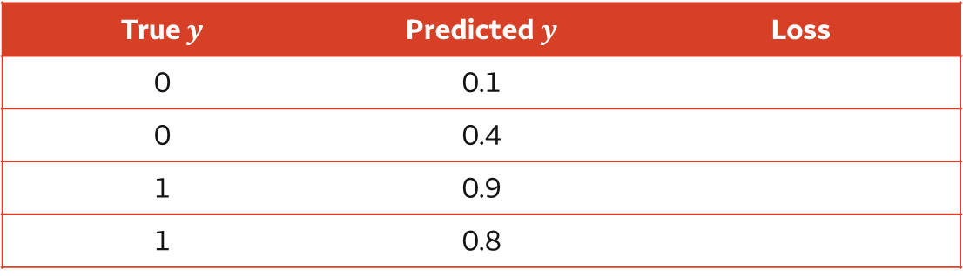

Practice
Cost function:
$$−\frac{1}{n}\sum_{i}{\left[y_{i}⋅\log\left({\hat{y}}_{i}\right)+\left(1−y_{i}\right)⋅\log\left(1−{\hat{y}}_{i}\right)\right]}$$
Consider the above set of observed and predicted values
Question 1: Which observation do you think contributes the most overall to the loss? The least?
Question 2: What is the total loss?
True $y$ | Predicted $y$ | Loss
0 | 0.1
0 | 0.4
1 | 0.9
1 | 0.8

Slide 21
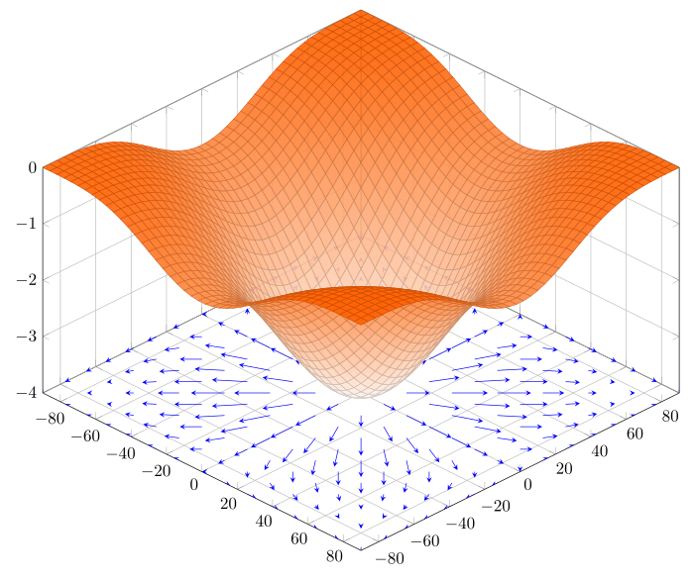
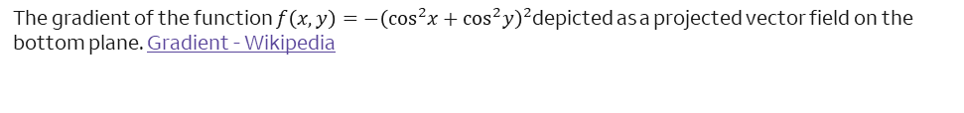
How to Train Neural Networks Gradient Descent
Iterative algorithm to minimize a function (in our case, the cost function w.r.t. weights)
Start with an initial set of weights.
Calculate the gradient (or slopes/ partial derivatives w.r.t. each weight) of the cost function.
Adjust the weights by a small multiple (learning rate) of the gradient.
Calculate the gradient of the cost function at new weights.
Repeat until the gradient becomes zero.
The gradient of the function $f\left(x, y\right)=−{\left(\cos^{2}x+\cos^{2}y\right)}^{2}$depicted as a projected vector field on the bottom plane. Gradient - Wikipedia

Slide 22
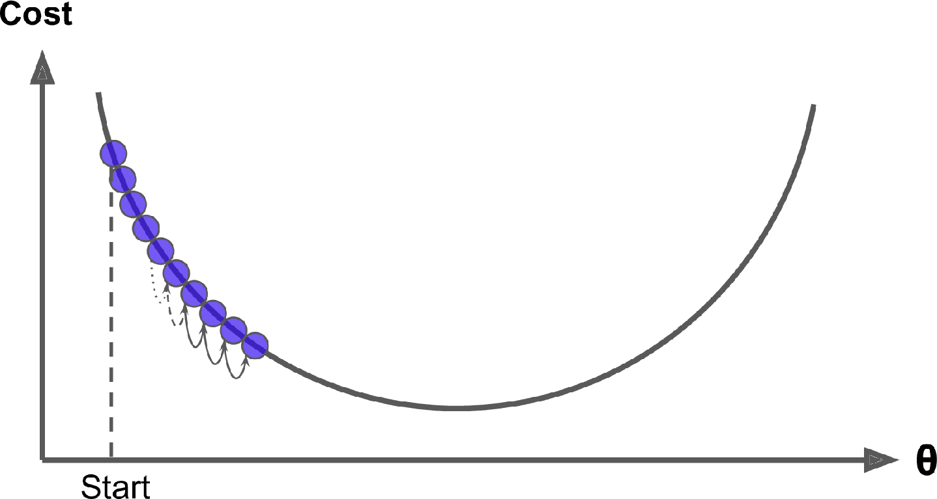
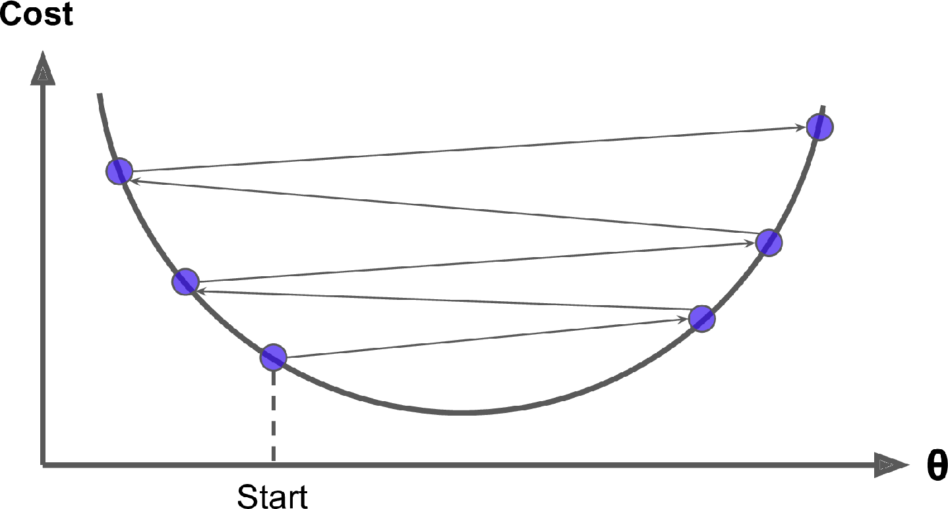
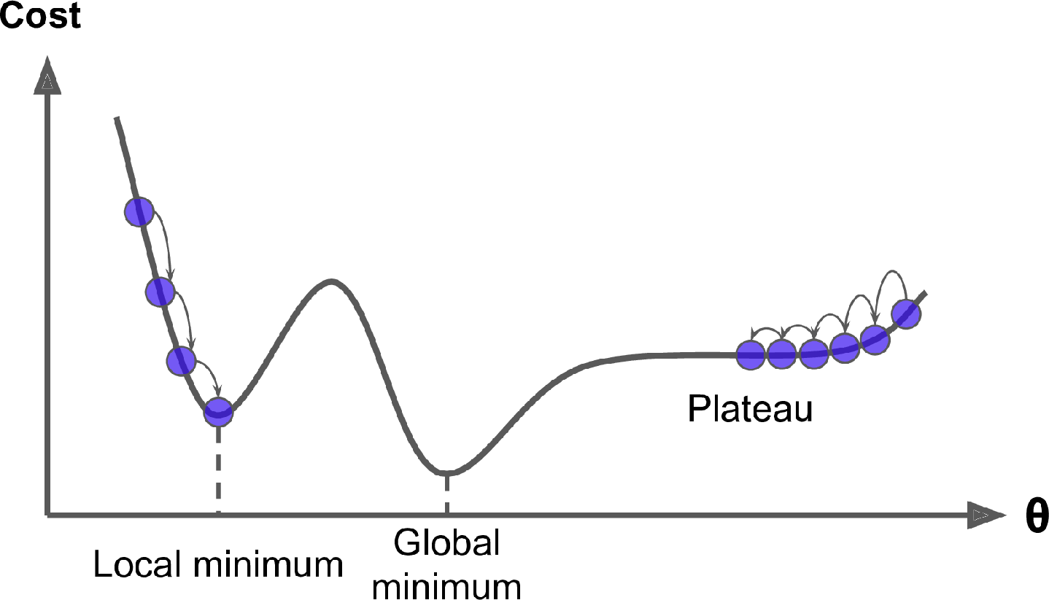
How to Train Neural Networks Gradient Descent
Step size (learning rate * gradient)
Learning rate too small: slow converge
Learning rate too large: unstable, diverge
Cost function shape:
Local minimum
Plateau
All three figures from: 4. Training Models - Hands-On Machine Learning with Scikit-Learn, Keras, and TensorFlow, 2nd Edition [Book] (oreilly.com)

Slide 23
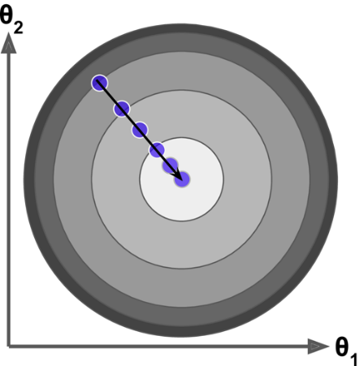
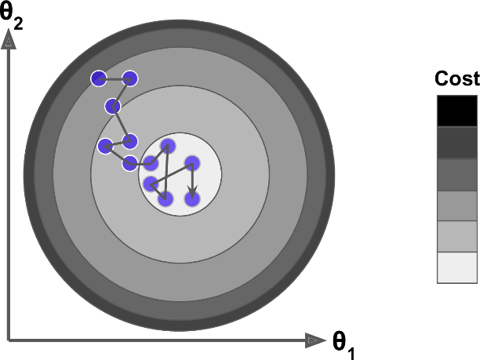
How to Train Neural Networks Gradient Descent
 | Batch | Stochastic (SGD) | Mini Batch
Training Sample | Whole data set | Randomly selected single sample | Randomly selected subset of samples
Time cost | High | Low | Medium
Property | Deterministic | Stochastic | Stochastic
Result | Optimal | Good but not optimal | Good but not optimal
Convergence | Slow | Fast | Medium
Best for | Small sample size | Huge sample size | Large sample size
All two figures from: 4. Training Models - Hands-On Machine Learning with Scikit-Learn, Keras, and TensorFlow, 2nd Edition [Book] (oreilly.com)

Slide 24
How to Train Neural Networks Backpropagation Algorithm
Feedforward
Feed the data through the network
Gradient
Compute the gradient of the cost function with respect to the last hidden layer/ output layer
Backward propagation
Work backwards through the network
Compute the gradient of the cost function in the lower layers using chain rule
Update
Compute the output of each node based on the current weights
Update the weights using gradient descent
Return to step 1 “Feedforward”
The Algorithm
The backpropagation algorithm was an important advancement that allowed training of deep neural networks to have some of their early successes.
Initialization (mini batch training)
Randomly initialize all the weights in the DNN
Randomly shuffle the training data set and split into mini batches
Algorithm: feedforward and backpropagation
Epoch: the whole data set pass the algo loop once.

Slide 25


Introduction to Keras and TensorFlow
Keras is TensorFlow’s high-level deep learning API.
It allows us to build, train and evaluate all sorts of neural networks.
Installation:
Command line: pip install TensorFlow
Google Colab: preinstallee
Documentation: https://www.tensorflow.org/

Slide 26
Introduction to Keras and TensorFlow Model and Layer
Main class: keras.Model( ) and keras.layers.Layer( )
Model object can be created by:
Sequential keras.Sequential( ) create a linear stack of layers. Simple architecture, beginner friendly.
Functional API keras.Model( ) support arbitrary architecture. Allow multiple inputs and multiple outputs.
Subclass of keras.Model: user write a subclass from scratch.
Layer object can be created by:
Calling predefined layer class: keras.Input( ), keras.layers.Dense( ) …
Specifying the shape of input (input layer), number of neurons (dense hidden layer) …
Specifying the activation function. The activation functions are the same for all nodes in the same layer.
Weights are initialized by layer weight initializer but can be overwritten.
Fully connected network: Every node in the same layer receives the same input from previous layer and sends the same output to the next layer.

Slide 27
TF/Keras Model and Layer
This is the number of neurons to include on that layer!
## Start with an empty model
model = Sequential()
## Add a hidden layer
model.add(Dense(30, input_dim=10 , activation='tanh'))
model.add(Dense(20, activation='tanh'))
## Add a hidden layer-- specify the dimension
model.add(Dense(1, activation='sigmoid')
The first layer needs to specify the number of features. Elsewhere, TF/Keras will figure this out for you!
Specify the activation function for the neurons on that layer.
Options: ‘sigmoid,’ ‘tanh,’ ‘linear,’ ‘relu,’ etc.
Remember that the output should match the response. Here, we have a binary response, so we use the sigmoid activation function.

Slide 28
TF/Keras Compile and Fit
Define an appropriate loss function for your response:
‘binary_crossentropy’ for binary ‘mean_squared_error’ for continuous
Choose an optimizer.
Good bets: ‘adam,’ ‘sgd’
## Compile the model
model.compile(optimizer='sgd', loss='binary_crossentropy', metrics=['acc'])
## Fit the model
hst = nn_new.fit(x, y, batch_size=50, epochs=250, verbose=0)
Nature of processing updates. Change to 1 for exciting updates!
The data: first predictors, then response
Batch Size: Number of observations to look at at a time
Epochs: How many times to look at the entire data set.

Slide 29


TF/Keras Learning curves
hst.history['loss’]: training loss vs epochs hst.history['val_loss’]: testing loss vs epochs
After training, we often examine the learning curves, which show the value of the cost function after each epoch.
Look for convergence and avoid overfitting in training.
cost
cost
epoch
epoch
Not yet converged
Overfit

Slide 30
Build, train and evaluate ANN with Keras
(1)
(2)
(3)
Load and prepare your data
In “real life,” this always takes the most time!
Create a model object using Sequential().
Add the layers you desire. Specify layer properties as you go. We will use Dense() layers.
(4)
(5)
(6)
(7)
Add an output layer.
Remember that the dimension should match that of the response, and the activation function should match.
Again, use Dense().
Compile your model.
Specify the loss function and optimizer.
Fit your model to data.
Various options are available.
Examine the training curve and evaluate model performance.
Adjust your model, and repeat as necessary.
(8)

Slide 31
Data Preparation
Feature Scaling and Transformation:
Avoid machine learning algorithm bias.
Min-max scaling/ normalization: subtract the min value, divide by |max - min|. Result range: [0, 1]
Standardization: subtract the mean value, divide by the standard deviation. Safe when a few outliers exist.
Handling Categorical Variables:
Machine learning algorithm prefers numerical data.
Convert categorial text variable to numbers: one hot encoding.
Dataset split: training set and testing set
Animal | Weight | Categorical Value
Cat | 10 | 1
Dog | 40 | 2
Rabbit | 6 | 3
Dog | 55 | 1
Cat | Dog | Rabbit | Weight
1 | 0 | 0 | 10
0 | 1 | 0 | 40
0 | 0 | 1 | 6
0 | 1 | 0 | 55

Slide 32
Choice to Make When Using Neural Networks
Network structure and properties
How many layers will you use?
How many nodes will be found in each layer?
Which activation function will we use?
Train the network effectively
Which training algorithm will we choose? (Consider using an algorithm with learning rate decay like Adam)
Which mini-batch size will we use (Smaller batches can be slower and more volatile, but can help escape local minima/saddle points)
How long will we train the network (number of epochs)?
Avoid overfitting!

Slide 33
Overfitting
Neural networks are flexible models, with a (potentially) large number of parameters – overfitting is a concern
Strategies to avoid overfitting in ANNs include:
Multiple narrow layers vs. single wide layer
Weight regularization: penalizing large weights in the cost function
Dropout: randomly set a fraction of neurons’ activations to 0 during training
Forces redundancy of neurons, and reduces neuron specialization
Early stopping via a validation data set

Slide 34
Time to build some networks!

Slide 35
Neural Networks Wrap-Up
Artificial neurons:
Receive input
Process input (weighted sum, activation function)
Send output
Single layer and multiple layer neural network:
Input layer
Hidden layers
Output layer
Neural network training:
Cost function
Gradient Descent
Feedforward and backpropagation algorithm
Keras & TensorFlow:
Sequential model
Dense Layer

